Slide 1
Psychology Presentation
Psychology Presentation
Psychology Presentation

Slide 2
Psychology Presentation
Psychology Presentation
Psychology Presentation

Slide 3
Psychology Presentation
Wali Muhammad
(2021-SE-39)
Wali Muhammad
(2021-SE-39)
Wali Muhammad
(2021-SE-39)

Slide 4
Psychology Presentation
Wali Muhammad
(2021-SE-39)
Wali Muhammad
(2021-SE-39)
Wali Muhammad
(2021-SE-39)

Slide 5
Topics to discuss
Introduction
Case Study
Results of the Case Study
Conclusion

Slide 6
Introduction
What is anxiety disorder and OCD

Slide 7
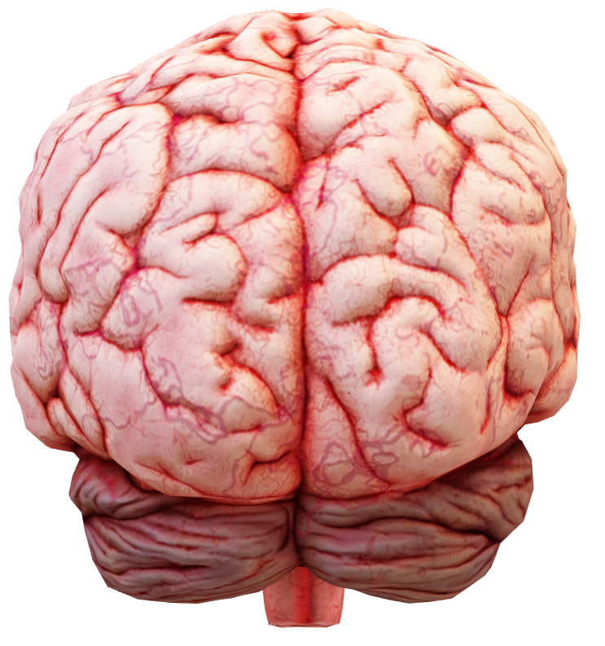
Introduction: Anxiety
Anxiety is the mind and body's reaction to stressful, dangerous, or unfamiliar situations.
Anxiety is a normal and often healthy emotion. However, when a person regularly feels disproportionate levels of anxiety, it might become a medical disorder.

Slide 8
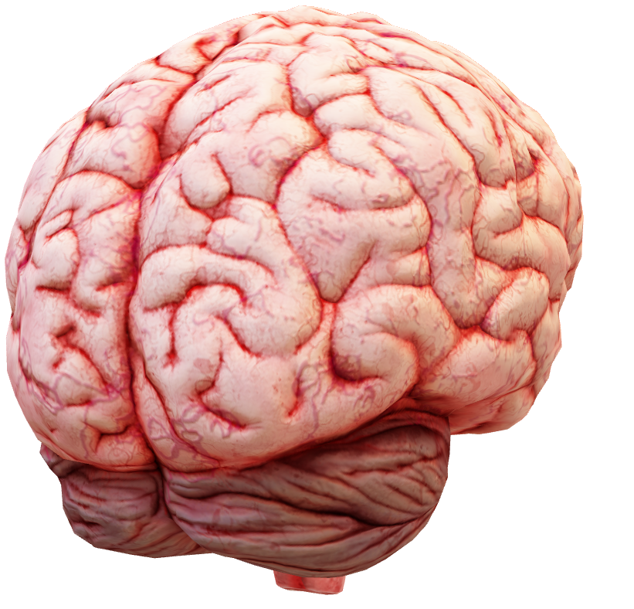
Introduction: OCD
Obsessive-Compulsive Disorder (OCD) features a pattern of unwanted thoughts and fears (obsessions) that lead to do repetitive behaviors (compulsions). These obsessions and compulsions interfere with daily activities and cause significant distress.

Slide 9
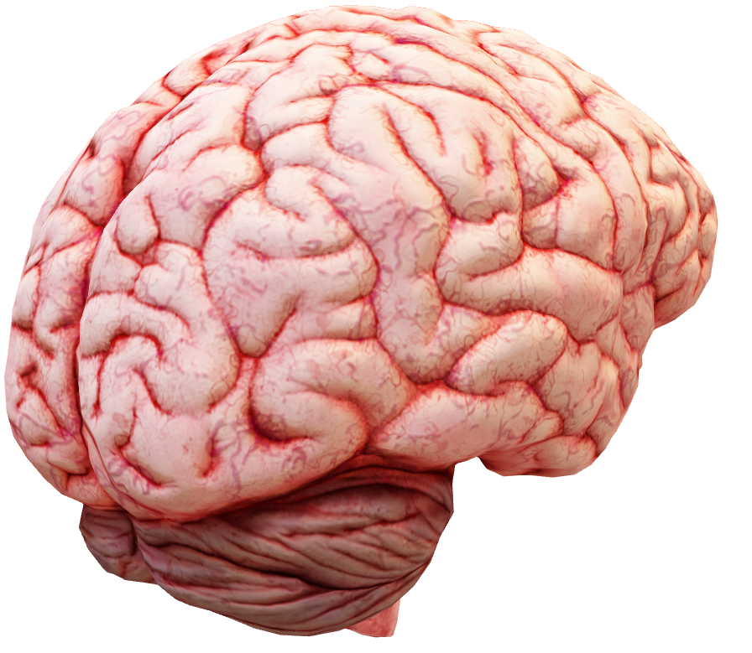
Obsession
Obsessions are unwanted thoughts, images, or urges that trigger intensely upsetting feelings. Compulsions are repetitive behaviors or mental acts that a person feels driven to perform to try to reduce anxiety or prevent something awful from happening.

Slide 10
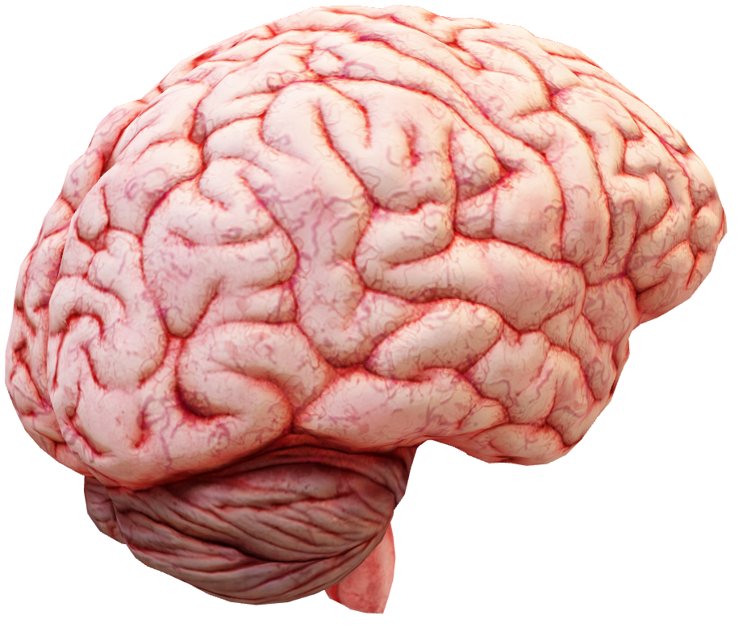
Anxiety disorder and OCD
Anxiety and OCD are often interconnected, as anxiety can trigger OCD symptoms and vice versa. When a person with OCD is unable to perform their compulsive behavior, it can lead to intense anxiety.

Slide 11
Case Study
A real life story of 16 years old boy

Slide 12
Case Study: Background
The case study is about a 16-year-old boy who committed suicide due to being a victim of psychological disorders, anxiety, and OCD.
He grew up in a home where he was ignored by his parents and his wishes and desires were not encouraged.

Slide 13
Psychological Effects: Anxiety and OCD
When he was old enough to understand the situation, he left home and sought help from relatives, but was instead mistreated and abused.
Discouragement and depression from both inside and outside cause him to became a victim of anxiety disorder, which later developed into OCD.

Slide 14
His final decision
Two days before this Ramadan, he heard that his mother is going to umrah so he reached to her for a farewell but he got a situation there.
Instead of treating him well on this moment she did ignore him and disliked his presence. This lead boy to take his final decision…

Slide 15
Tragic Outcome: Suicide of a Young Boy
He came home cried, and the next morning they found him hanging with ceiling.
The boy's father was an advocate at the Lahore High Court and chose to cover up his son's death to avoid negative attention.
My elder brother is also advocate and works with him so eventually he came to know about this news and told me.

Slide 16
Results
Psychological Disorder and anxiety

Slide 17
Psychological and Anxiety Disorders in the Boy's Case
The boy suffered from depression due to neglect and discouragement from his parents.
He developed anxiety as he grew up and was tormented mentally by his parents.
He was physically abused by his father, which further added to his anxiety and fear.
He experienced extreme emotional distress and hopelessness, leading to his suicide.

Slide 18
Is this a dead end?
The boys parents should sort out their own issues and
Seek support and guidance to cop such situation from a trusted adult
Tell his sufferings to psychological specialist

Slide 19
Conclusion
Psychological Disorder and anxiety

Slide 20
Conclusion
In conclusion, the case study of the young boy highlights the devastating impact of psychological disorders and anxiety.
It is crucial for parents and caregivers to listen to the concerns of their children and provide them with the resources they need to manage their mental health.
We must prioritize the well-being of individuals and work towards creating a society that fosters understanding and support for those experiencing mental health challenges.

Slide 21

Thank You!

